Slide 1
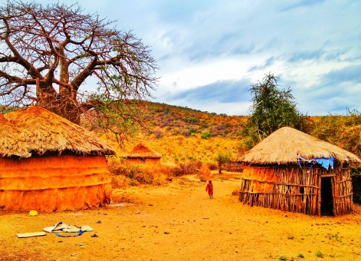

N R E G A A n a l y s i s
( U s i n g P o w e r B I)
This Photo by

Slide 2

This scheme was introduced to increase the purchasing power of low-income individuals in rural India, particularly semi-skilled and unskilled laborers.
The main objectives of NREGA is to create durable assets and infrastructure in rural areas that can improve the quality of life and productivity of the rural population.
The mandate of the Act is to provide at least 100 days of guaranteed wage employment in a financial year to every rural household whose adult members volunteer to do unskilled manual work.
N R E G A S C H E M E
O V E R V I E W

Slide 3
Following are the 5 Questions we will analyzing the NREGA ANALYSIS: 1. How effective is NREGA in providing employment opportunities to rural households? 2. Are there regional disparities in the implementation and outcomes of the scheme? 3. What is the utilization of the allocated budget, and how does it correlate with employment generation? 4. What are the key factors contributing to the completion of NREGA works, and are there any roadblocks to its success? 5. Can data-driven insights guide policymakers and administrators in optimizing the scheme's impact?

Slide 4
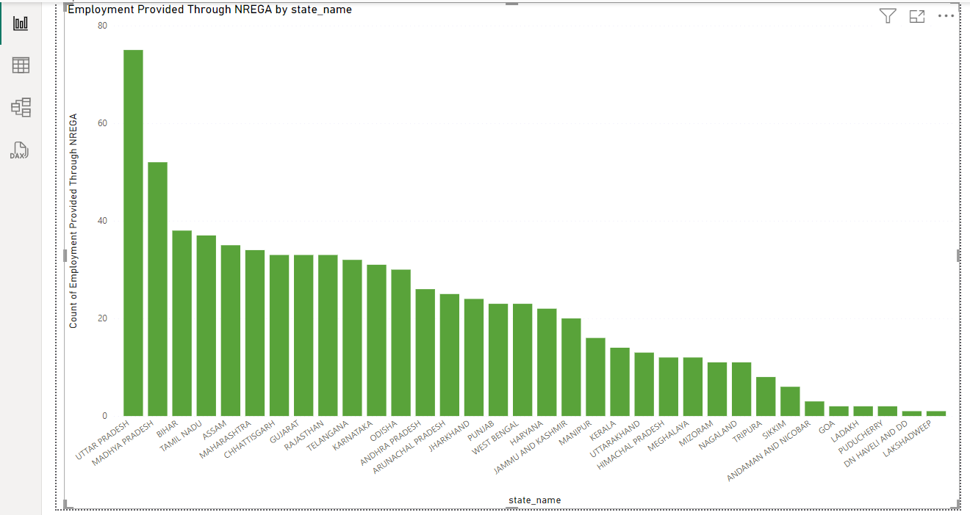
How effective is NREGA in providing employment opportunities to rural households?
Employment Provided Through NREGA was highest for UTTAR PRADESH, followed by MADHYA PRADESH and BIHAR.﻿﻿ ﻿﻿
﻿﻿UTTAR PRADESH accounted for 10.14% of Count of Employment Provided Through NREGA.﻿﻿ ﻿﻿

Slide 5
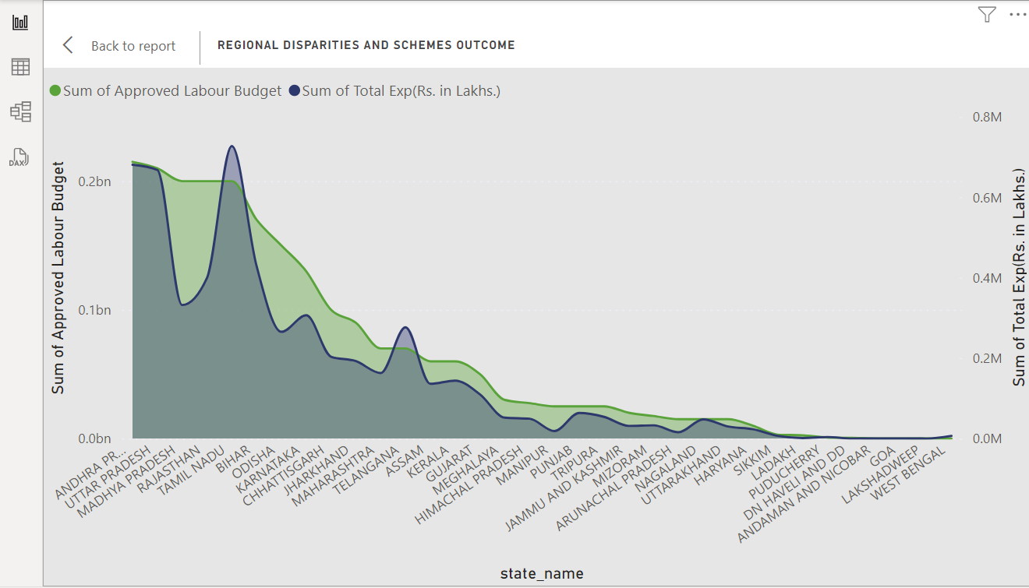

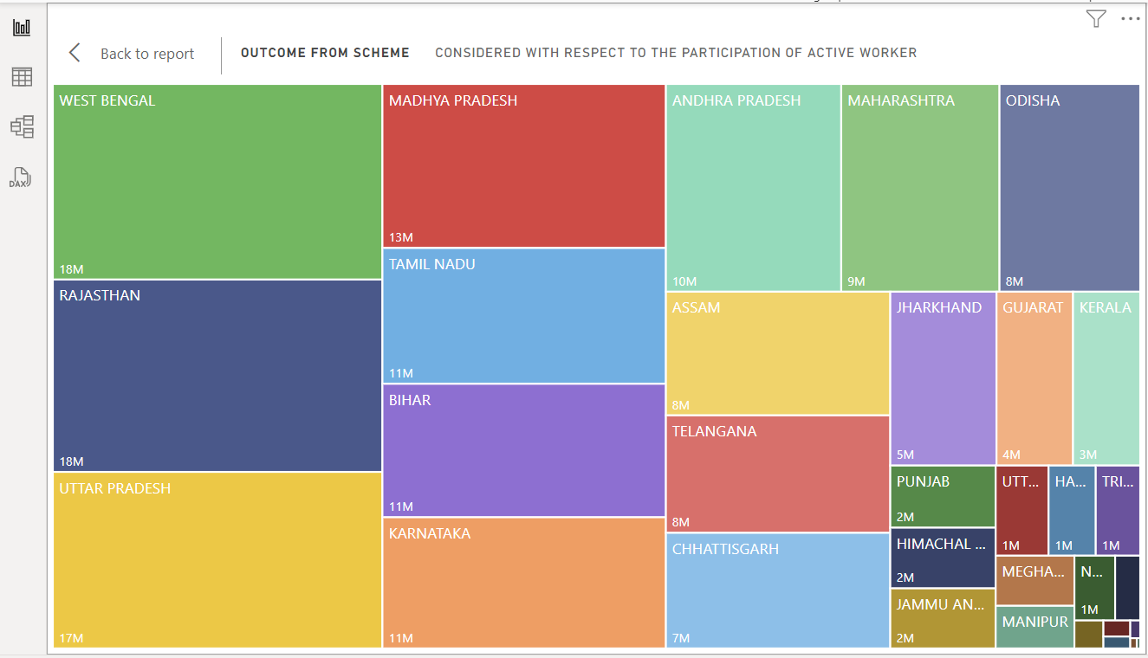
Are there regional disparities in the implementation and outcomes of the scheme?
Regional Disparity
2Bn
Was the Budget Approved
5.47M
Was the Total Exp.
Scheme Outcome
Scheme Outcome
Approved Labour Budget and Total Exp. Are positively correlated with each other. As a result more workers got active during this scheme.

Slide 6
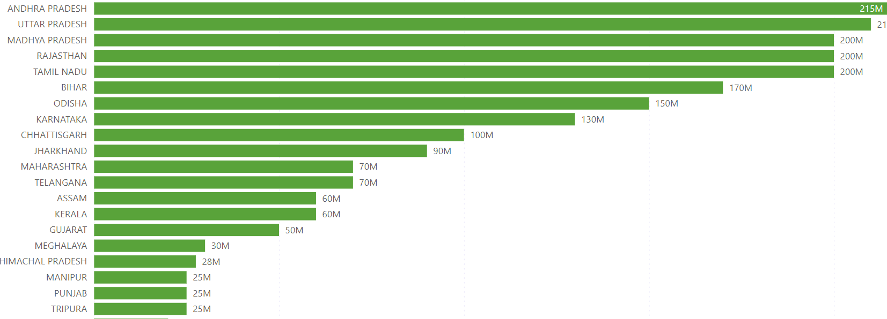
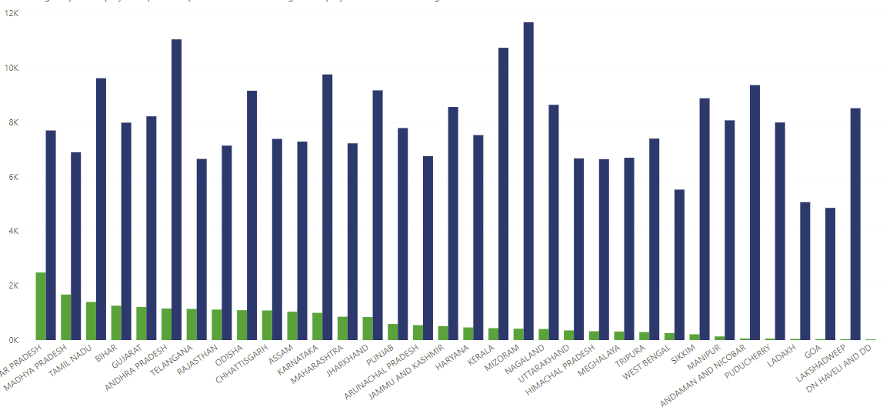
What is the utilization of the allocated budget, and how does it correlate with employment generation?
UTILIZATION OF BUDGET:
The budget was utilized in a significant allocation which shows the disparity as well that can be analyzed from the given chart. Moreover a brief detail has been provided below:
At 215000000, ANDHRA PRADESH had the highest Approved Labour Budget followed by UTTAR PRADESH and MADHYA PRADESH and was Infinity higher than WEST BENGAL, which had the lowest Approved Labour Budget at 0.﻿﻿
﻿﻿ ﻿﻿ANDHRA PRADESH accounted for 9.74% of Approved Labour Budget.﻿﻿ ﻿﻿ ﻿﻿Across all 34 state name, Approved Labour Budget ranged from 0 to 215000000.﻿﻿ ﻿﻿ ﻿
CORRELATION WITH EMPLOYMENT GENERATION
Despite being the higher budget approved in Andhra Pradesh and higher employment provided to Uttar Pradesh,
﻿Average of Employment Provided Through NREGA and Sum of Average days of employment provided per Household diverged the most when the state name was MIZORAM, when Average of Employment Provided Through NREGA were 11244 higher than Sum of Average days of employment provided per Household.

Slide 7
What are the key factors contributing to the completion of NREGA works, and are there any roadblocks to its success?
CONTRIBUTING KEY FACTORS ARE:
Active Job Cards and Workers.
Engagement of SC’S, ST’S and Women.
Expenditure on Agriculture and it’s allied work.
ROADBLOCKS
Distribution of funds to Gram Panchayat.
Coordination with differently abled person.
Allocation of Budget to the regional area with respect to the challenges.

Slide 8
Can data-driven insights guide policymakers and administrators in optimizing the scheme's impact?
Absolutely! Data-driven insights play a pivotal role in shaping effective policies and optimizing the impact of government schemes. Let’s explore how:
1.NREGA, a transformative scheme, provides guaranteed wage employment to rural households in India. By analyzing NREGA data, policymakers and administrators can:
Budget Allocation Optimization: Understand which regions require more funding for effective implementation.
Workforce Engagement Strategies: Identify areas with high workforce demand and tailor engagement strategies accordingly.
Impact Assessment: Evaluate the scheme’s effectiveness by tracking work completion rates and employment generation.
Regional Disparities: Uncover disparities across states and districts, allowing targeted interventions.
Transparency and Accountability: Ensure transparency in fund utilization and minimize leakages.
2.Armed with data, policymakers can fine-tune NREGA, ensuring it uplifts rural communities sustainably.

Slide 9
CONCLUSION
Budget Allocation Optimization:
Challenge: NREGA’s success hinges on efficient fund allocation. How can we ensure every rupee counts?
Data-Driven Solution: Analyze historical spending patterns, regional needs, and project demand. Allocate funds dynamically based on workforce availability and project pipeline. Prioritize areas with high unemployment rates
Workforce Engagement Strategies:
Challenge: Engaging rural workers effectively is key. How do we match demand with supply?
Data-Driven Solution: Leverage real-time data on job seekers, skill sets, and project availability. Implement targeted awareness campaigns, skill development programs, and mobile job portals. Tailor engagement strategies to local contexts.
Impact Assessment:
Challenge: Is NREGA truly transforming lives? How do we measure success?
Data-Driven Solution: Track work completion rates, employment generation, and wage disbursement. Use predictive models to assess long-term impact on poverty reduction, education, and health outcomes. Benchmark against global best practices.
Regional Disparities:
Challenge: India’s diversity demands tailored interventions. How can we address regional disparities?
Data-Driven Solution: Visualize data geospatially. Identify pockets of underutilization or overutilization. Prioritize resource allocation based on need—whether it’s drought-prone regions, tribal belts, or flood-affected areas.
Transparency and Accountability:
Challenge: Leakage and corruption erode NREGA’s impact. How do we ensure transparency?
Data-Driven Solution: Implement blockchain-based transaction tracking. Publish real-time expenditure data. Enable citizen feedback mechanisms. Use data analytics to detect anomalies and prevent misuse.

Slide 10
Gratitude To Mentorness!
Your Suggestions & Feedbacks are Acceptable.

